Slide 1


Using Python to Assess Serial Holdings Data in the Research Library
Kelly Thompson
twitter.com/info_grrl
University of Minnesota Libraries
#SciPy2018 Conference
2018-07-11
Notes:
Hello. My name is Kelly Thompson, and I work at the University of Minnesota Libraries.

Slide 2

CC-BY-Sharealike Tony Webster, 2007
Notes:
https://www.flickr.com/photos/diversey/24424603414/in/photostream/
I work on the secret 5th floor of this building, Wilson Library. My training and background are in library and information science. By title I used to be a Metadata Librarian, but I was recently reclassified into an IT track as a data and systems analyst. I have been learning Python gradually over the past several years, starting when I was in grad school and really picking up over that last two years as I’ve really had an opportunity to integrate it into my daily library data workflows. This talk is to share with you how I have applied open tools from the Scientific Python computing community in my library data workflows. For the sake of scope, I’m going to talk about one particular data problem in the environment of the large academic research library. – serials collection management.
I would like to start with introducing you to the problem space that academic libraries find themselves in currently.

Slide 3
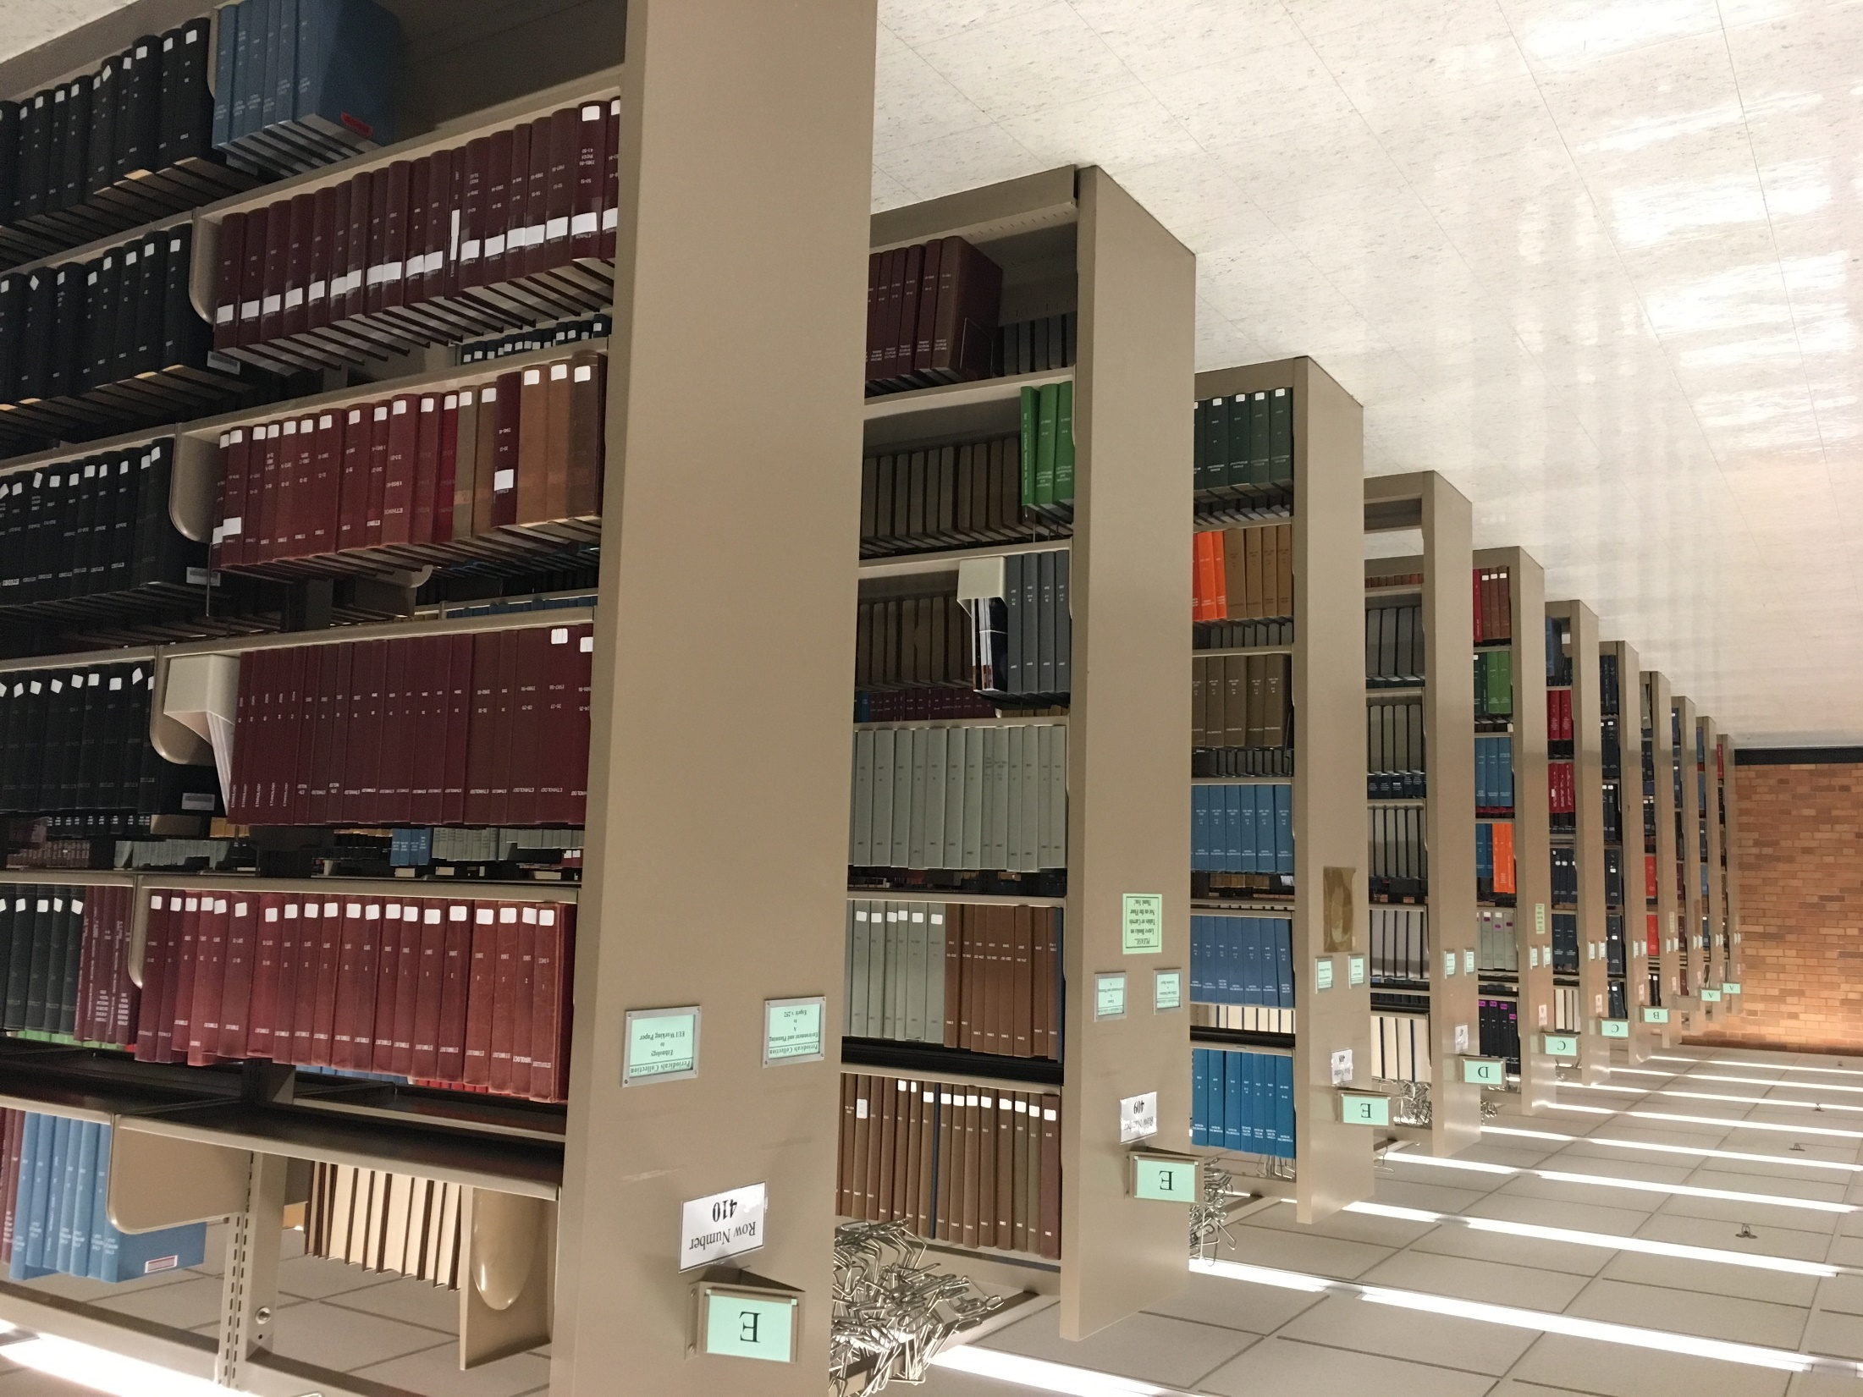
Notes:
Libraries have been collecting, stewarding, and providing access to information objects for decades, in some cases centuries. Our collections cover an incredible time span (some of our oldest materials are cuneiform tablets from between 3000 and 2000 BCE) to the most recent electronic medical journal article indexed in PubMed. We are stewards of physical resources, yes, but more and more we are facilitators of access to information and scholarship services, increasingly in digital formats.

Slide 4
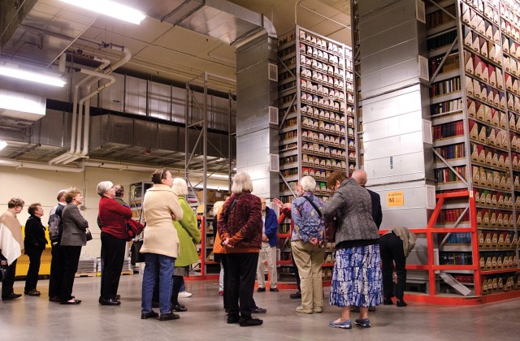
Image source: University of Minnesota “Continuum” newsletter
Notes:
https://www.continuum.umn.edu/2015/09/year-in-pictures-2015/
And, Because we are stewards of centuries of physical manifestations of intellectual outputs, you can imagine that we have reached capacity in our physical spaces. Despite the fact that we have build a giant cathedral to books inside a cave in a cliff overlooking the Mississippi River, which runs through our campus.

Slide 5




Image sources: University of Minnesota Libraries Continuum newsletter
Notes:
https://www.continuum.umn.edu/2016/10/wilson-library-changes/
https://www.continuum.umn.edu/2017/05/paws-returns-wilson-library/
https://www.continuum.umn.edu/2018/07/local-8th-graders-visit-u-for-sports-history-day-proj
https://hsl.lib.umn.edu/biomed/at-the-library/study-spaces/study/groupsect/
This problem comes at a time when our space, as many on campus, are challenged to be more creative and flexible with our spaces. We are being asked by our administrations to create more student-friendly study spaces, teaching and learning spaces supporting new modes of pedagogy, cafes, group study spaces, data visualization labs, and so on. At a time when our physical footprint of resources is at its largest, we need it to be shrinking.

Slide 6
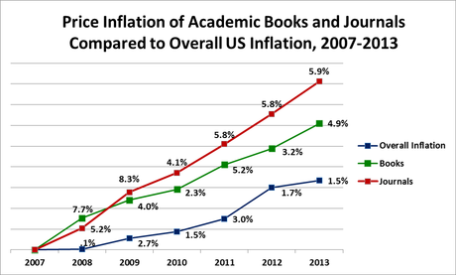
Image Source: “Budget Challenges,” UC Santa Barbara Library (http://www.library.ucsb.edu/collection-development/budget-challenges, accessed 4/18/2016)
Notes:
For the majority of disciplines we serve, electronic resources have become the format of choice. Most of these resources are in the form of serials, or continuing resources, a broad category used by librarians to encompass publications such as journals, society and conference proceedings, government documents issued on a recurring basis, book series, etc.. Serials published by for-profit publishers have price tags that continue to climb at rates much higher than inflation, at a time when our budgets are stagnant or reduced. The number of publishers and vendors who can provide us with these resources has shrunk to less than a handful (affectionately known as the “Big Four”).
This environment is leading to a louder call to critically examine our practices in this area. Libraries have identified a number of actions we can take to work in this problem space, such as forming open access publishing units to keep the means of production of scholarship in the hands of scholars, educating researchers on their intellectual property rights as authors – if you are associated with a public or large University, please talk to your librarian before you sign another publication contract – we can often give you boilerplate language to use in negotiating keeping your copyright, and we are critically examining our relationships with vendors.
It is with the vendor relations, the negotiations of the contracts we sign in order to access electronic resources that we encounter a big question of access: if we decide to discontinue purchasing a title, how much, if any, of the content we have been licensing will we retain access to? The answer can range from “none” to “some” to “unknown”. This “post-cancellation access” also brings up the issue of digital preservation. If a journal publisher is acquired by a larger publisher or goes out of business, do we trust that they will continue to provide indefinite access to the retrospective electronic resources we previously had contracted with them to provide?? Ongoing access to these resources is a big question, and library consortia have been working together to address it. And in the meantime, we have to keep moving forward with our work and providing access to our communities of library users, and fulfilling our other roles on our campuses.

Slide 7


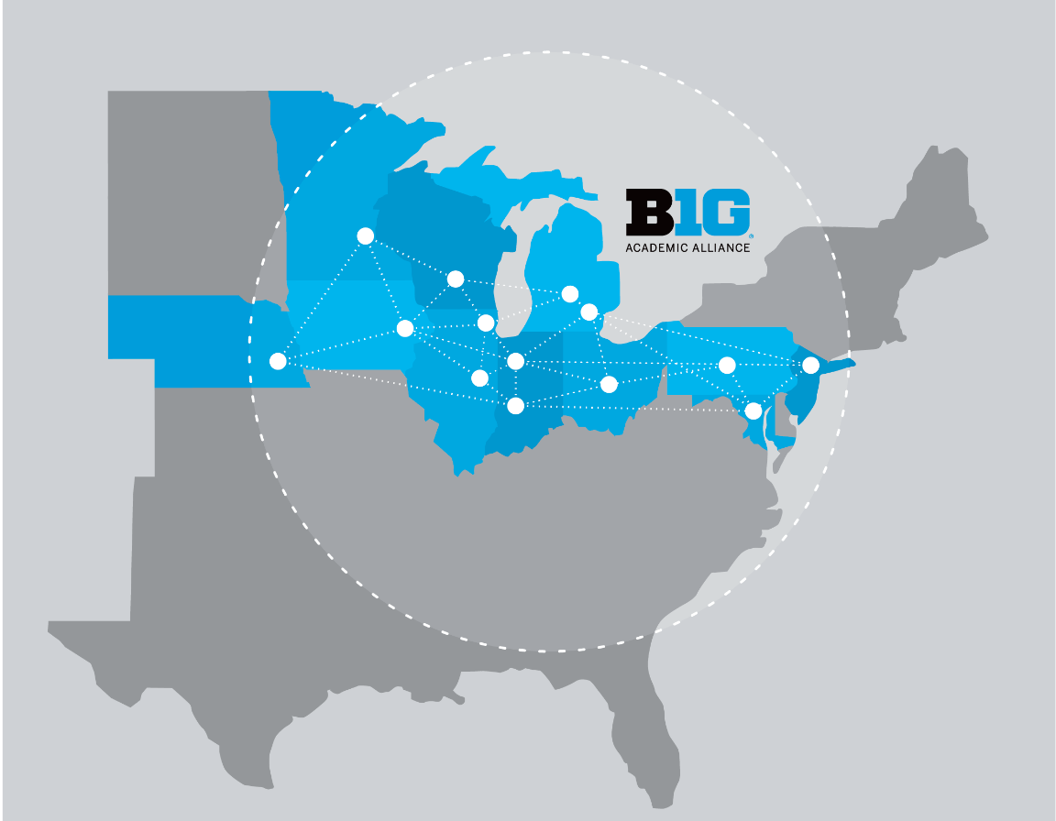
https://en.wikipedia.org/wiki/HathiTrust; https://www.btaa.org/library/libraries; http://openpreservation.org/about/members/portico/
Notes:
Fortunately, now is also a time when additional intercampus collaborations are springing up to address these questions. One example is the increasing movement among library consortia and membership organizations to collectively inventory disparate resources and create shared catalogs or “meta-collections” of national/consortial collections, drawing from the collections which individual local institutions steward and agree to preserve in place. These types of sharing arrangements have existed for a long time (Our library users have been fondly familiar with our inter-library loan services for decades), but these consortial relationships have become even more important in today’s environment. These relationships can offer us new decision-making frameworks in our collection management policies. Through these sharing arrangements, we make commitments to retain specific titles on behalf of the larger community of libraries, we gauge the type and expediency of access we could expect to access materials retained by other institutions or through post-cancellation access via our vendors, and we balance these assumptions as we make retention or withdrawal decisions.

Slide 8
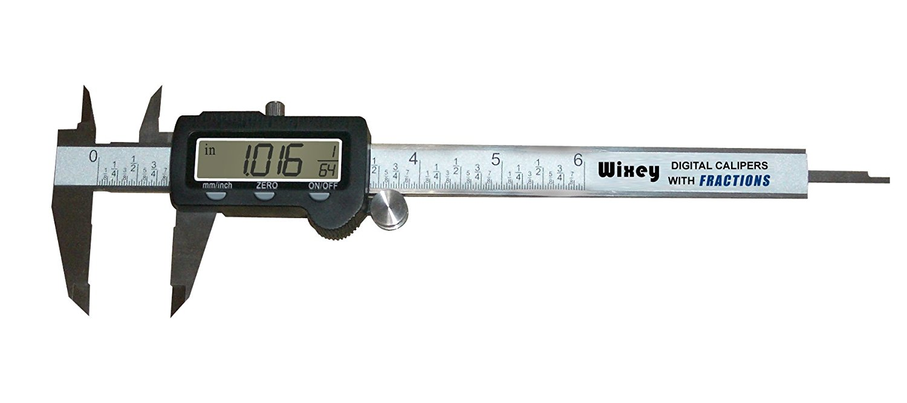
Post-cancellation access (PCAD)
Physical serials
Electronic serials
Weeding locations
Trusted repositories
Notes:
So… we need to get rid of non-unique, non-rare, unused resources to make room for ways of using library spaces in support of teaching and learning. We need to know which titles we hold in both in a physical format on our shelves, and in an electronic format. We need to know if we have on-going access if we cancel our subscription, and we need to know if the title is preserved in a trusted repository. We have made commitments to consortial efforts to retain certain materials on behalf of a larger community, and we are hoping to rely on other community efforts to supply materials outside the scope of what we wish to retain. Only then can we start looking at these candidate titles to see if they are in any of our weeding target locations. And, ideally, we would like some kind of measure, such as number of volumes, since the bosses are thinking in linear feet of shelf space.
Identify print titles for which we have no post-cancellation electronic access
Identify print titles for which we have post-cancellation electronic access, AND which are preserved in Portico and/or BTAA SPR
Identify print titles for which we have post-cancellation electronic access which are NOT in Portico and/or BTAA SPR (could we contribute physical items to SPR, clearing shelf space locally and contributing to collective preservation efforts)
So, identify print candidates for withdrawal, which is the set of titles where we have ongoing electronic access, the title is also satisfactorily preserved somewhere else (for these purposes – Portico or the Big Ten Academic Alliance Shared Print Repository), and don’t get rid of anything rare, unique, or which we’ve committed to retain in place.

Slide 9
Goals
Compare physical holdings of resources to electronic resources
Filter for post-cancellation access (from backfiles list maintained by Electronic Resources librarian)
Filter for items held in trusted repositories (Portico, BTAA SPR, may add JSTOR?)
Exclude any titles with retention commitments (HathiTrust SPR, Government Documents)
Notes:
It is out of this context that the project I will be describing for you arises. Spearheaded by a Collections Management committee at my library, the main goals of this data analysis were to:
Compare physical or print holdings of resources to electronic resources to which we can reasonably expect post-cancellation access (determined by a contracts person in our acquisitions office.)
Take this list of items, and find the titles where we can reasonably expect access from one of two currently-available trusted repositories (electronically from Portico, or physically, through the Big Ten Academic Alliance Shared Print Repository in Indiana.)
Then we need to double-check this list to make sure we haven’t made outside commitments to retain these items through our consorital partnerships and in our role as a federal United States government documents depository library.
We have also made retention commitments through the HathiTrust shared print program and need to take into consideration availability of resources need to meet accreditation requirements for a number of academic and professional programs on campus. We also need to maintain records of what we have owned historically, because we participate in sharing our collections for scanning for Google Books, and through the agreement, copies of scanned resources are deposited not only with Google, but with HathiTrust. While any member of the public can visit HathiTrust and see out-of-copyright digitized works, our library users can log in and access some in-copyright works if our library has demonstrated ownership through a separate data workflow (which I also manage for our library).

Slide 10

Serials: the life of the party
Cover image from U.S. National Oceanic and Atmospheric Administration - http://fishbull.noaa.gov/index.html, Public Domain, https://commons.wikimedia.org/w/index.php?curid=64097983
Notes:
Serials: the life of the party.
It gets more complicated. Serials are the life of the library metadata party, yielding what I would consider to be some of the most complex bibliographic and inventory data in our library systems. It’s important to know that serials are complicated works – the are born birth, they merge, they split up, they change their names slightly on every issue cover, they spawn subseries, sometimes they die, and sometimes they just kinda ghost on you.
Serials have volumes, issues, their frequency of publication varies, editors retire, etc. This all means that serials have complicated relationships with each other that are challenging to represent in data. It also means that when we want to look at a title and compare online versus print access, we often need to look at a cluster, or family of records. While print serials usually have one record per major title change, electronic serials often have vendor-provided records which often compile an entire run under one title, usually the most recent form. We hope that our records have what we refer to as linker fields, 76X, 77X, or 78X fields which describe a relationship between the title described by the record and another title. Each field describes a specific type of relationship, which is further described by the indicators and subfields used. The most important data in these fields are identifiers.

Slide 11
“Enum/Chron”
Enumeration
no.1
v.7
4/5
v.3:no.20-24
32-40
Chronology
2016
1994-95
1995/1996
01/1905-
Fall 1817
Description (combination)
412-416 (2011-2012)
v.7:no.3-10 (2007)

Slide 12
Library data has to live somewhere…
Bib record (physical manifestation of work)
Bib record (electronic manifestation of work)
Holdings
Location 1
Holdings
Location 2
Electronic Collection 1
Barcode 1
Barcode 2
URL 1
URL 2
URL 3
Barcode 3
Notes:
Most libraries use a large data system referred to as an integrated library system, or ILS, to manage the majority of their data about their library collections. Almost all libraries purchase rights to use these systems from an ever decreasing number of vendors for large sums of money. The system we use has what I think of as a tiered, inheritance data model. You have bibliographic or descriptive data for a title in a particular format, you have holdings data which indicates the libraries and locations where our physical holdings are located, and you have item-level data in the form of a record for every barcode in the system. For Electronic resources, the structure is similar: You have bibliographic/descriptive data for an electronic title, the title has items in the form of portfolios, which are containers for URLs and access rights information, and these portfolios may or may not belong to electronic collections. All of these collections and items have purchase order data, use data, associated patron data, etc.

Slide 13
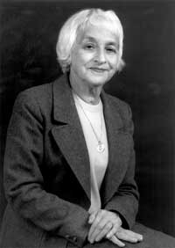
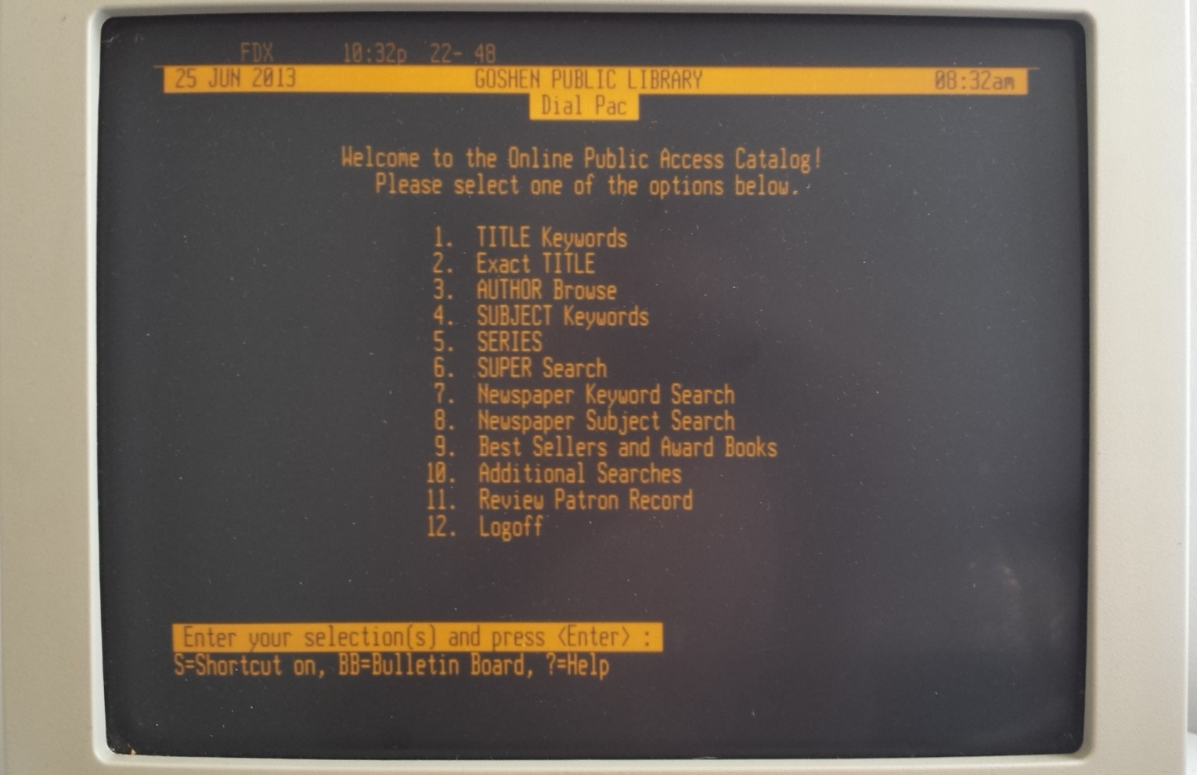
A bit about MARC
Henriette Avram
https://en.wikipedia.org/w/index.php?curid=31808124
Dynix menu: Skylarstrickland, CC BY-SA 3.0, https://commons.wikimedia.org/w/index.php?curid=30191622
Notes:
Library data is stored in a format called MARC, which is an acronym for MAchine Readable Cataloging. It was developed in the 1960s by a systems analyst at the Library of Congress named Henriette Avram. This standard was developed to facilitate the transition from paper card catalogs to the first computer catalogs being developed around that time at Ohio State and others. The second image is of a Dynix menu, which was one of the first library systems to become commercially widely available to libraries in the 80s. While some minor aspects of the MARC standard have changed over the years, it remains largely the same as it was originally conceptualized, over 50 years ago.

Slide 14
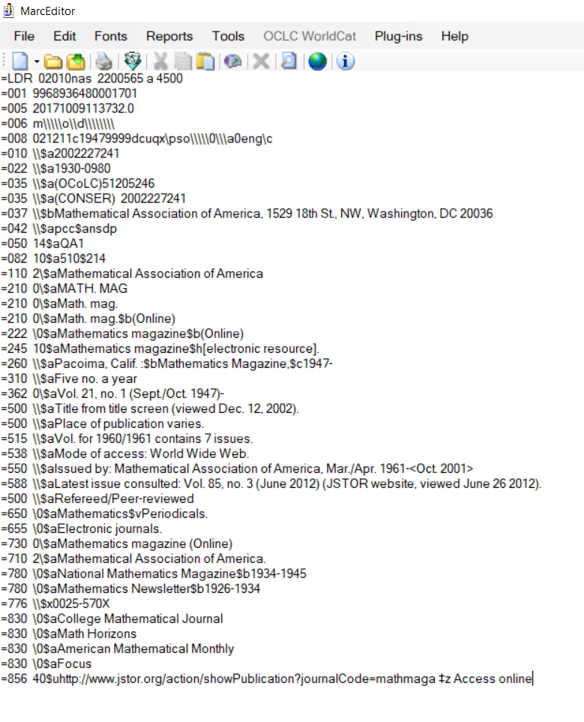
=LDR 02010nas 2200565 a 4500
=005 20171009113732.0
=006 m\\\\\o\\d\\\\\\\\
=008 021211c19479999dcuqx\pso\\\\\0\\\a0eng\c
=245 10$aMathematics magazine$h[electronic resource].
=260 \\$aPacoima, Calif. :$bMathematics Magazine,$c1947-
=310 \\$aFive no. a year
=362 0\$aVol. 21, no. 1 (Sept./Oct. 1947)-
=500 \\$aTitle from title screen (viewed Dec. 12, 2002).
=500 \\$aPlace of publication varies.
Notes:
Here is an example of a typical MARC serial record, as I would interact with it in the wild. The standard proscribes the MARC record structure of Leader, directory, fixed fields, and variable field data. The standard contains rules for which content to put in which field, two indicators for each field that carry coded data, and subfields. The Content of these data elements is ruled by additional standards (previously AACR2, but moving forward in RDA). The resulting records can be serialized in a number of formats – binary, pneumonic, and XML are the most common.
As you can see from this example record, the data points we are interested in are distributed across very granular fields. Flattening the data is incredibly lossy –
once we take the data out of the record, we lose a lot of context if we’re not careful to retain the necessary identifiers for rematching. We’re also often navigating trees, if we’ve mapped holdings and items into the bib record or if the record is serialized as XML.
Data that we extract from our ILS typically is in the form of binary MARC data. We have to map inventory data into the bib records when we export them.
However, the data that we have about post-cancellation access, retention commitments, and what is held in trusted repositories typically is serialized in spreadsheets, as this data is not currently stored in our ILS system (we’re working with our vendor on this).

Slide 15
Identifiers
=001 9968936480001701
=010 \\$a2002227241
…
=035 \\$a(OCoLC)51205246
=035 \\$a(CONSER) 2002227241
=022 \\$a1930-0980
=780 \0$aNational Mathematics Magazine$b1934-1945
=780 \0$aMathematics Newsletter$b1926-1934
=776 \\$x0025-570X
Notes:
Serials typically are registered through the library of congress for an ISSN or [International Serial Number]. This is typically a 9 character identifier, 4 digits followed by a hyphen then four more digits or the letter X. I’ve highlighted the ISSNs in the example record: the main ISSN in the 022 field subfield x, related ISSNs or cancelled ISSNs in other 022 subfields, and other related title ISSNs in the 7XX linker fields.
Another identifier we’re interested in is the OCLC number, or the identifier for the record in a major shared national database of records.

Slide 16
On to the Python!
Notes:
So, on to the Python!
Now is the time for some caveats. I am a domain knowledge expert when it comes to library data. However, I am not an expert when it comes to all things Python and mathematics. This is not a talk about how I created the most advanced, ingenious thing. This is a talk about how I used free, openly available tools, found resources for learning them, and applied them to a complex, real world problem in an environment where this is not an established practice. Most libraries undertaking these kinds of analyses have had to struggle through a lot of manual work, or have had to rely on vendors or consultants to do these kinds of analyses for them. This talk is to say, we can be doing this for ourselves! I am Python, and so can you.

Slide 17
Pymarc
https://github.com/edsu/pymarc
Primary authors: Ed Summers, Mark Matienzo, Gabriel Farrell and Geoffrey Spear
There is a Google group!
Notes:
The first step in a Python analysis of libraries data has to be getting the data into a form appropriate for analysis. For this work, I have been extracting the data into Pandas dataframes.
So, in order to get something that looks like this into a dataframe, we can either manually use a program called MarcEdit to extract tab-delimited values from the fields we are looking for, and read the text file. While this method is very fast and provides a handy user interface, it doesn’t give us the same control that programmatically parsing the records does where we can implement conditional loops and pre-filter values. There is a specialized library for doing just this called PyMARC, which we use to parse the data into records, fields, subfields, and the actual content. Frequently PyMARC is used to simply read in a file, make changes or filter according to a set of rules and export as MARC for reingest into a system. However, for these analyses, I need to merge in a lot of external data, so I am reading into a Pandas DataFrame. PyMarc was originally written by Ed Summers, Mark Matienzo, Gabriel Farrell, and Geoffrey Spear, and there is a Google group which is very responsive to beginners’ questions.

Slide 18
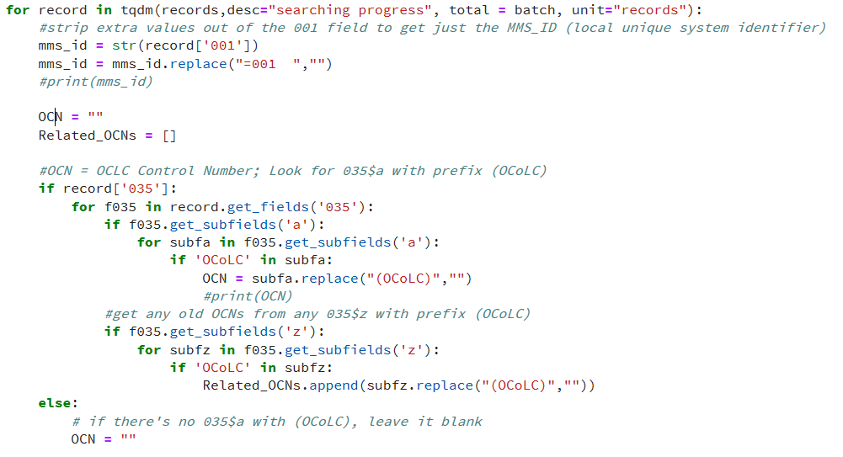

Slide 19
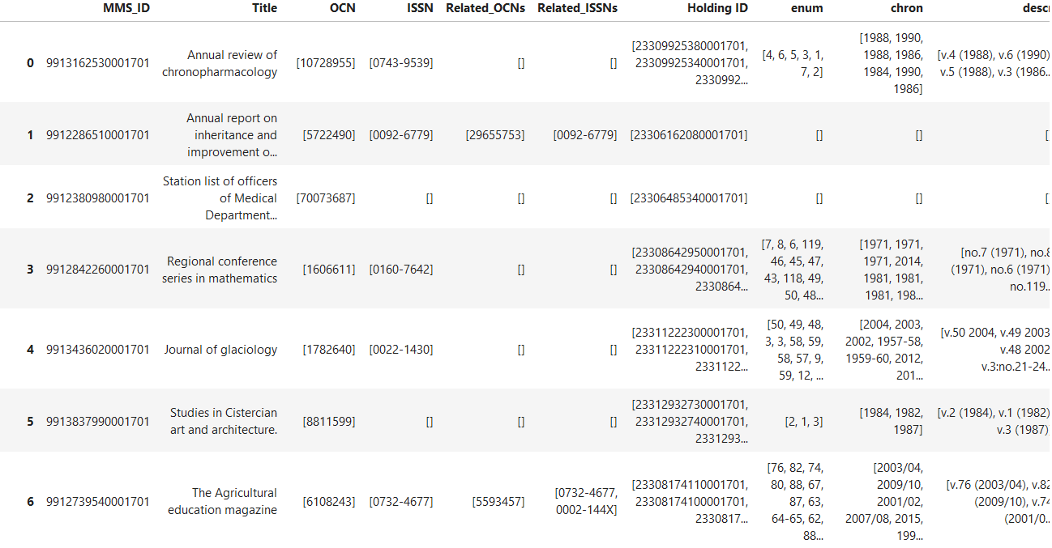
pandas
Notes:
As I said, I read the MARC data I’m interested in into a Pandas DataFrame. For those of you not familiar with Pandas, a dataframe is like a spreadsheet with magic powers. They are like database tables in that you can perform database-style joins on them, but there are also a lot of built-in statistical methods and the like

Slide 20
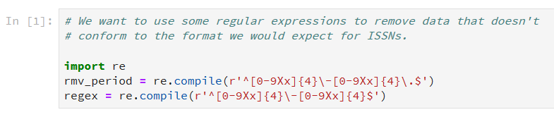
Regular expressions
ISSN examples:
2574-1500 (ADVANCES in pharmacy)
0097-966X (Digest of Technical Papers)
Notes:
Once I’ve parsed the MARC data I’m interested in into a dataframe, there’s often a lot of cleaning necessary. Our database is like a longitudinal, legacy dataset, over 50 years old, worked on by hundreds of people with varying knowledge levels and containing records from possibly thousands of sources. The content standards have shifted over the years, as has the structural standard itself. Human error and maintenance glitches are a fact of life.
Beyond the MARC data, the other sets of data we’ll be merging in come from several sources, most of which are closed systems, and are not able to be queried on the fly, so we’re working with static data. One of the principles that we work on is that once the data has left any of the systems we work on, it is already old, it is aging with every minute, so you need to make sure that any analyses you are presenting to decision-makers ephasizes this.
So, just as with most other analyses starting with raw data, we need to do a lot of processing and cleaning before we can use them. I write a lot of regular expressions to clean ISSN or OCN data that is parseable as such. Any data which doesn’t match the expected form and can’t be read by the script as a meaningful value is filtered out of the analysis to avoid false matches. This data is also exportable by the script as a report, so I can give it to our serials catalogers who work on the nitty gritty of this data. We can exclude those data for now, but I know they will haunt us again and again, so it would be nice to get it cleaned up in the database for when we pull data for our next analysis.

Slide 21
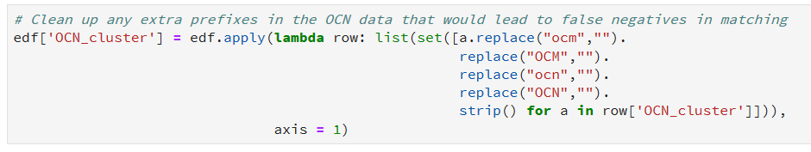
Replace

Slide 22
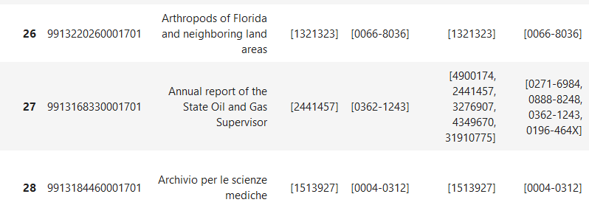
Grouping
List comprehension versus normalized data forms.

Slide 23
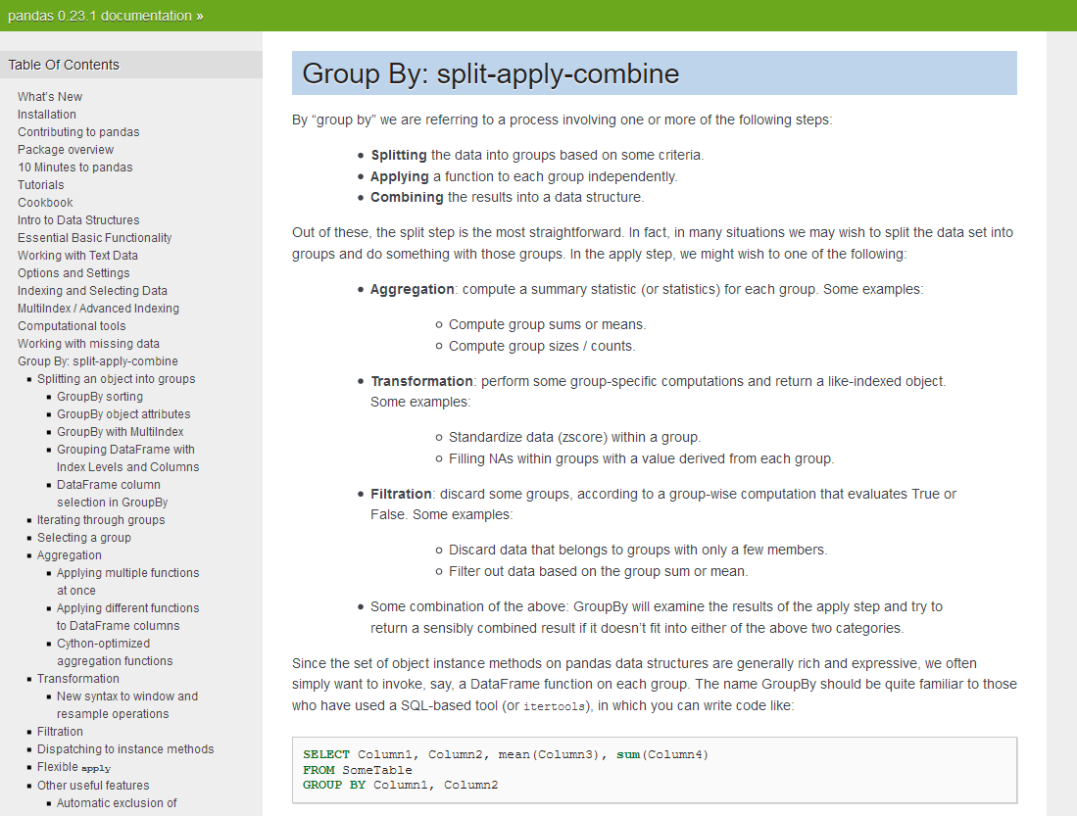
https://pandas.pydata.org/pandas-docs/stable/groupby.html

Slide 24
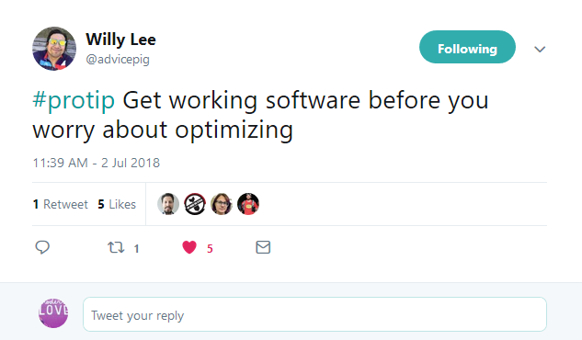
https://twitter.com/advicepig/status/1013824506169831425

Slide 25
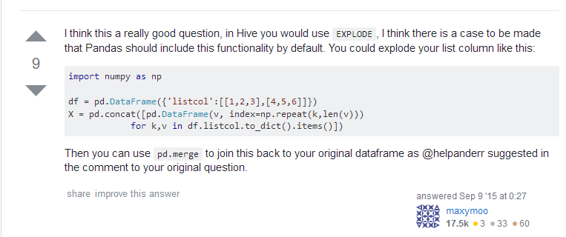
https://stackoverflow.com/questions/32468402/how-to-explode-a-list-inside-a-dataframe-cell-into-separate-rows
Notes:
Max Flander @maxymoom

Slide 26
Formatting data
Normalize the table –
Tidy data = one observation per cell
Use indexes as temporary record identifiers
Call Pandas Group-by function
Parse the group object to get the group numbers and put them into a dataframe with the record IDs
This can yield multiple group numbers per record ID
Need to reduce multiple group numbers into a single group number, then ‘defrag’ that list to a complete list
Sort by group number for display
Record index | Identifier cluster
0 | A, B
1 | B
2 | C
Record index | Identifier cluster
0 | A
0 | B
1 | B
2 | C

Slide 27
Formatting data
Normalize the table –
Tidy data = one observation per cell
Use indexes as temporary record identifiers
Call Pandas Group-by function
Parse the group object to get the group numbers and put them into a dataframe with the record IDs
This can yield multiple group numbers per record ID
Need to reduce multiple group numbers into a single group number, then ‘defrag’ that list to a complete list
Sort by group number for display
Record index | Identifier cluster
0 | A
0 | B
1 | B
2 | C
Record index | Group ID
0 | 0
0 | 1
1 | 1
2 | 2

Slide 28
Formatting data
Record index | Group ID
0 | 0
0 | 1
1 | 1
2 | 2
Normalize the table –
Tidy data = one observation per cell
Use indexes as temporary record identifiers
Call Pandas Group-by function
Parse the group object to get the group numbers and put them into a dataframe with the record IDs
This can [will] yield multiple group numbers per record ID
Need to reduce multiple group numbers into a single group number, then ‘defrag’ that list to a complete list
Sort by group number for display
Record index | Group ID
0 | 0, 1
1 | 1
2 | 2
Record index | Identifier cluster
0 | A, B
1 | B
2 | C

Slide 29
Formatting data
Normalize the table –
Tidy data = one observation per cell
Use indexes as temporary record identifiers
Call Pandas Group-by function
Parse the group object to get the group numbers and put them into a dataframe with the record IDs
This can yield multiple group numbers per record ID
Need to reduce multiple group numbers into a single group number, then ‘defrag’ that list to a complete list
Sort by group number for display
Record index | Group ID
0 | 0, 1
1 | 1
2 | 2
Record index | Group ID
0 | 0
1 | 0
2 | 2

Slide 30
Run this algorithm multiple times
Splitting data sets into workable chunks (matching)
Clustering
ISSNs
OCNs

Slide 31
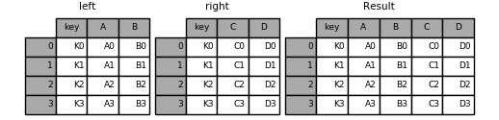
After clustering, add in other data and filter
Merging
Database style joins of pandas
Slicing
Reporting
Source: pandas “Merge, join, concatenate” documentation, https://pandas.pydata.org/pandas-docs/stable/merging.html

Slide 32
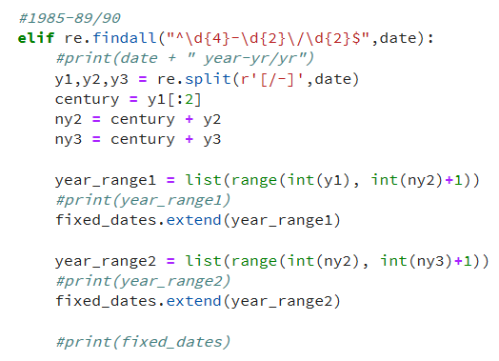
Normalizing Enum/Chron – MORE REGEX!!

Slide 33
Next Steps
Percentage overlap
More granular coverage data (issue/volume)
Investigate querying sources on-the-fly (developments among consortial programs)
Turn functions into a Python package?
Extracting serials-pertinent data from MARC file
Clustering function(s)
Enum/chron parsing regexes
Try out different data structures in the future??

Slide 34
Benefits & Challenges
Benefits
Reproducible workflows
Extensible
Uses actively maintained tools
Challenges
Data sources
Work load
Chugging through large data sets
Opportunities
Jupyter Hub on HPC at the Supercomputing Institute at the UMN
New libraries to try

Slide 35

Foundations + Gratitute
Shawn Averkamp, got me started on metadata and Python.
My first foray into pandas was via a tutorial in a GitHub repository from a workshop called “Measure your Metadata” by Shawn Averkamp, Sara Rubinow, Matt Miller, Josh Hadro (https://github.com/saverkamp/measure-metadata-workshop)

Slide 36

Foundations + Gratitute
Haowei Hsieh, Computing Foundations and Databases course professor, and graduate advisor.

Slide 37
Foundations + Gratitute
Data carpentry: Python for ecologists
Lesson Maintainers: April Wright, Tania Allard
Self-paced lesson modules
https://datacarpentry.org/python-ecology-lesson/

Slide 38
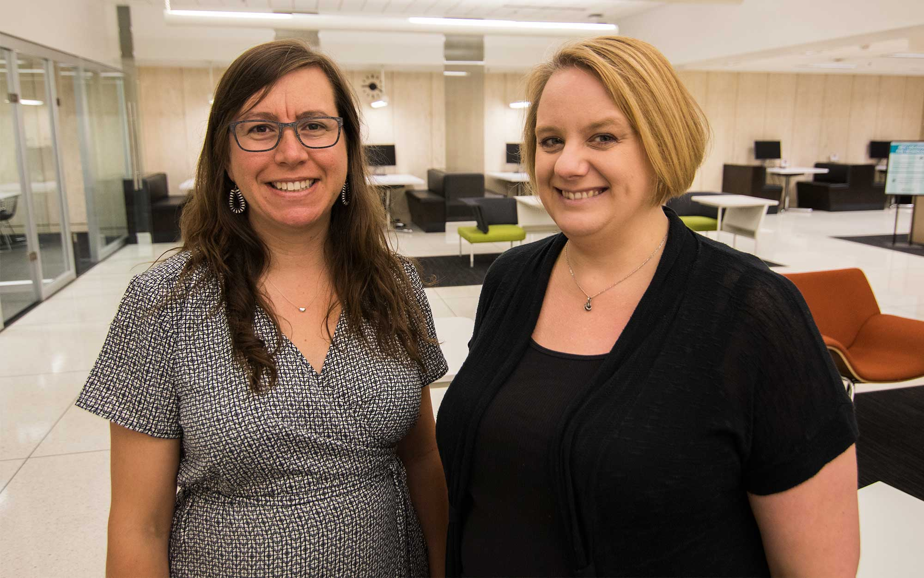
Foundations + Gratitute
My co-workers Stacie Traill and Sunshine Carter, who are on the journey too.

Slide 39
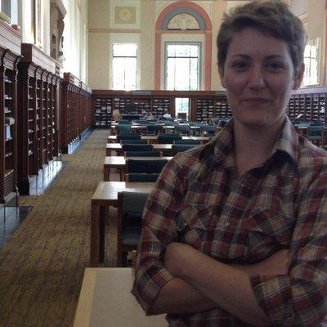
Question time
https://github.com/UMNLibraries/serials_clustering
twitter.com/info_grrl

